Slide 1

Employee payroll Management
System
GROUP - 7
232 Java Batch

Slide 2

Group Members
Sallapa Gari Sai Kumar 2575473
Sandeep H N 2575952
Sapna Kumari 2576410
Saranya R 2577174
Seru Venkata Phani 2576987
Shaik Abdulrasheed 2577014
Shaik Ashiq Basha 2576345
Shaik Najeemm 2576579

Slide 3
Contents
Introduction
Objective
Tools & Languages Used
Features of Employee Payroll Management System
Advantages
App Flow
E-R Diagram
Screen Shots Of Output and details
Conclusion

Slide 4
Introduction
Employee payroll management system is an Internet-based Java application that automates the working of a company or work center that manage and maintain records of the employees in the different department.
The proposed project “Employee Payroll Management System” has been developed to overcome the problems faced in the practicing of manual system.
This web application is reduced as much as possible to avoid errors while entering data. It also provides error message while entering invalid data.

Slide 5
objective
The Primary objective of the design is to deliver the requirement as delivered by the feasibility report. There are some objective we kept in mind.
Practically : The system is quite stable and can be operated by the Employees with average intelligence.
Efficiency : We tried to involve accuracy, timeliness and comprehensiveness of system output.

Slide 6
Tools & Languages
Front End:
Visual Studio
Angular
HTML
CSS
BOOTSTRAP
Back End
Eclipse
MySQL
Spring Data JPA
Postman

Slide 7
Features of Employee Payroll Management System
Admin can do :
Adding Employees.
Adding Salary for Employees.
Adding leaves for Employees.
Can Schedule work to Employees.
Can Add Attendance to Employees.

Slide 8
Features of Employee Payroll Management System
Employees can do :
View and Edit their Profile.
View their Approved Leaves.
View their Attendance.
View their Assigned Work Details.
View and Download their Salary Slips.

Slide 9
Advantages
Helps the employee easy way to access their data.
The information related to employee can be added , edited, removed easily.
Store the end-to-end data of the employees
Provides transparency in salary calculations, contributing to employee trust and satisfaction

Slide 10
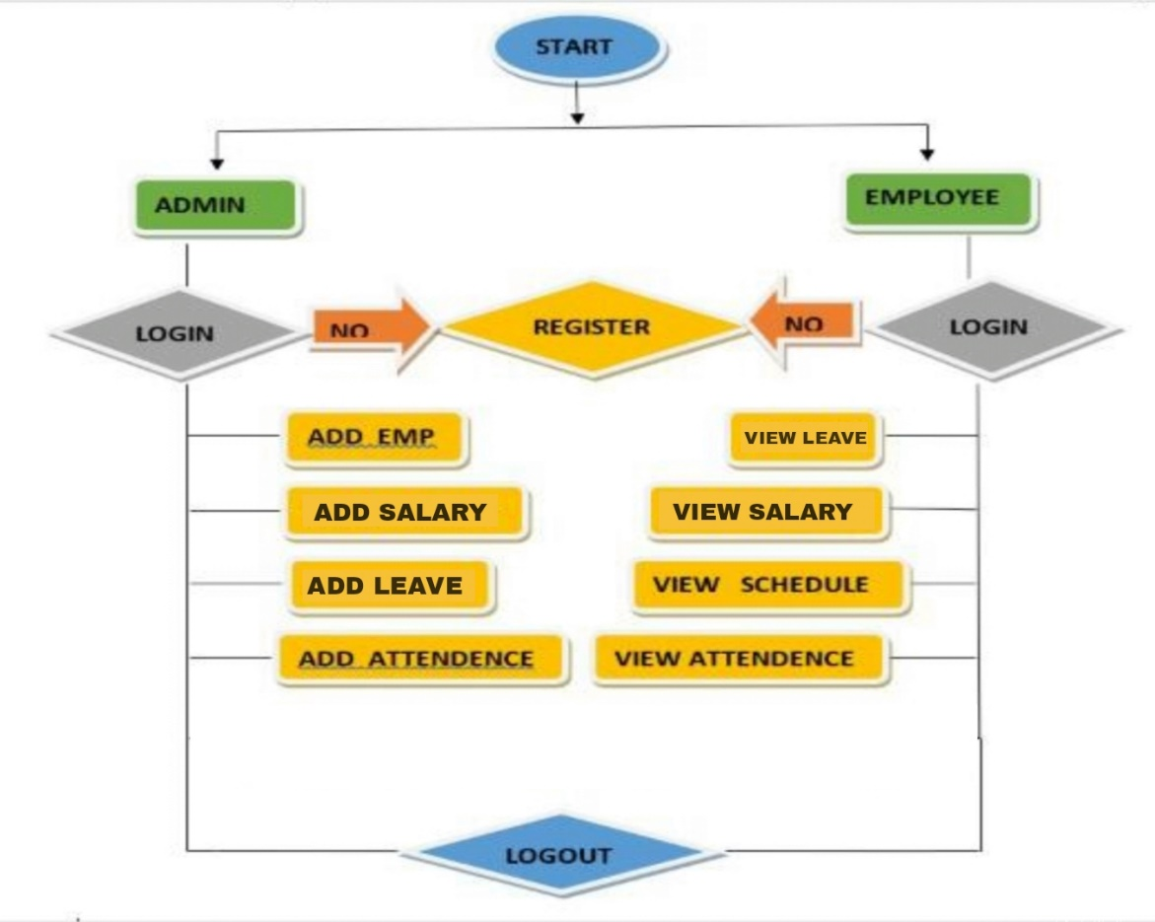
App Flow:

Slide 11
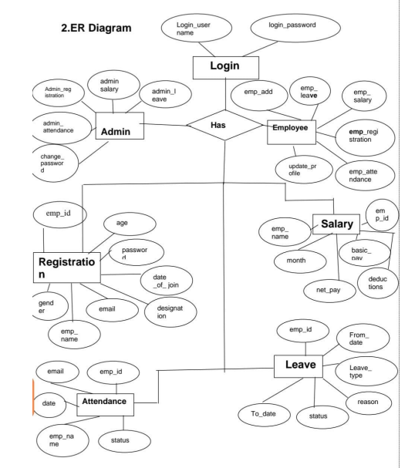
E-R Diagram:

Slide 12
Screenshots Of Output and Details

Slide 13
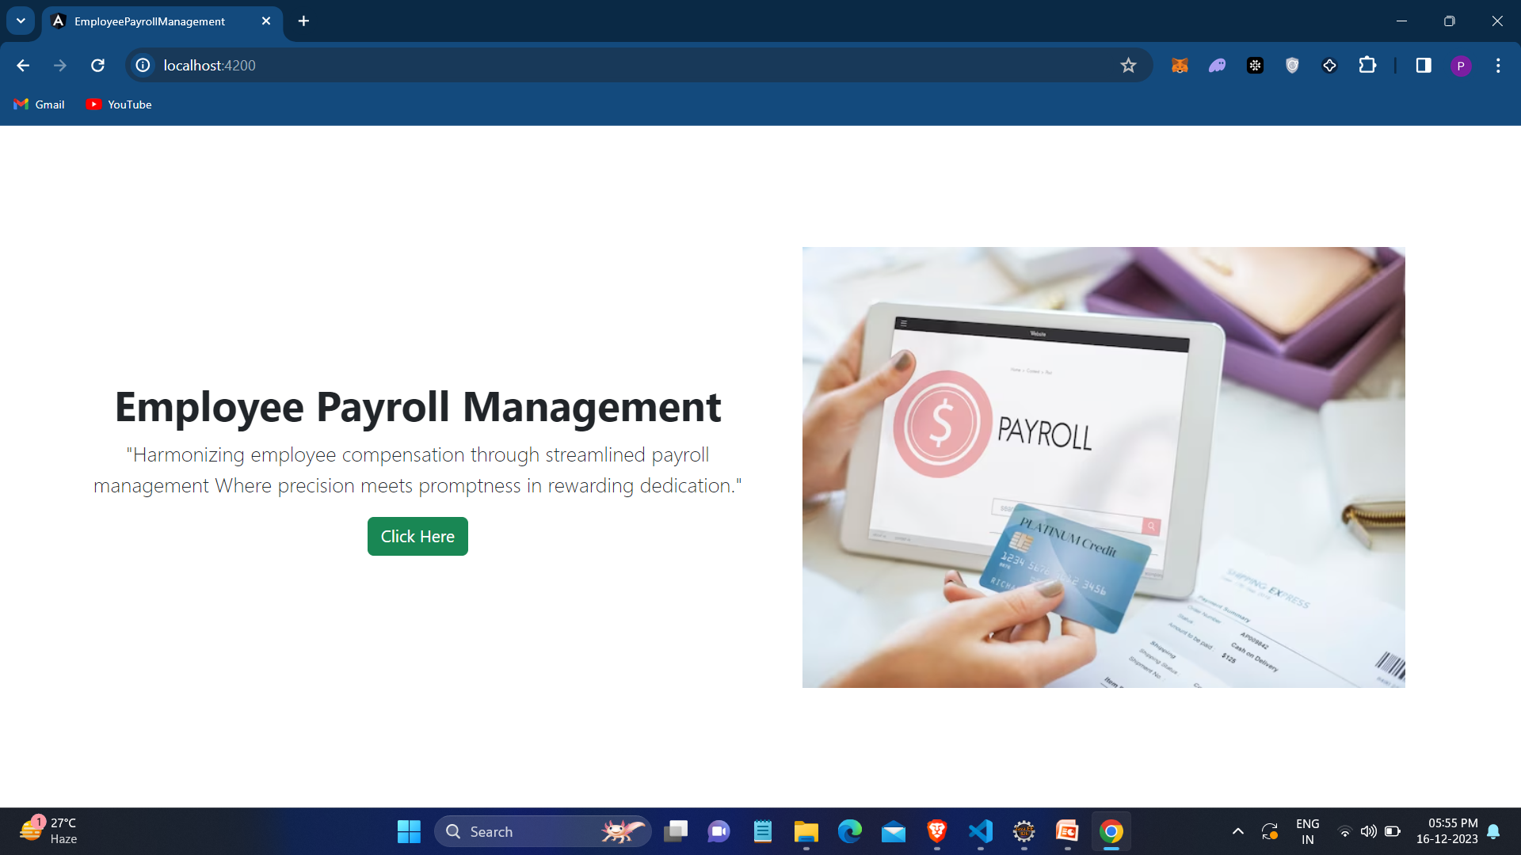
Home Page:

Slide 14
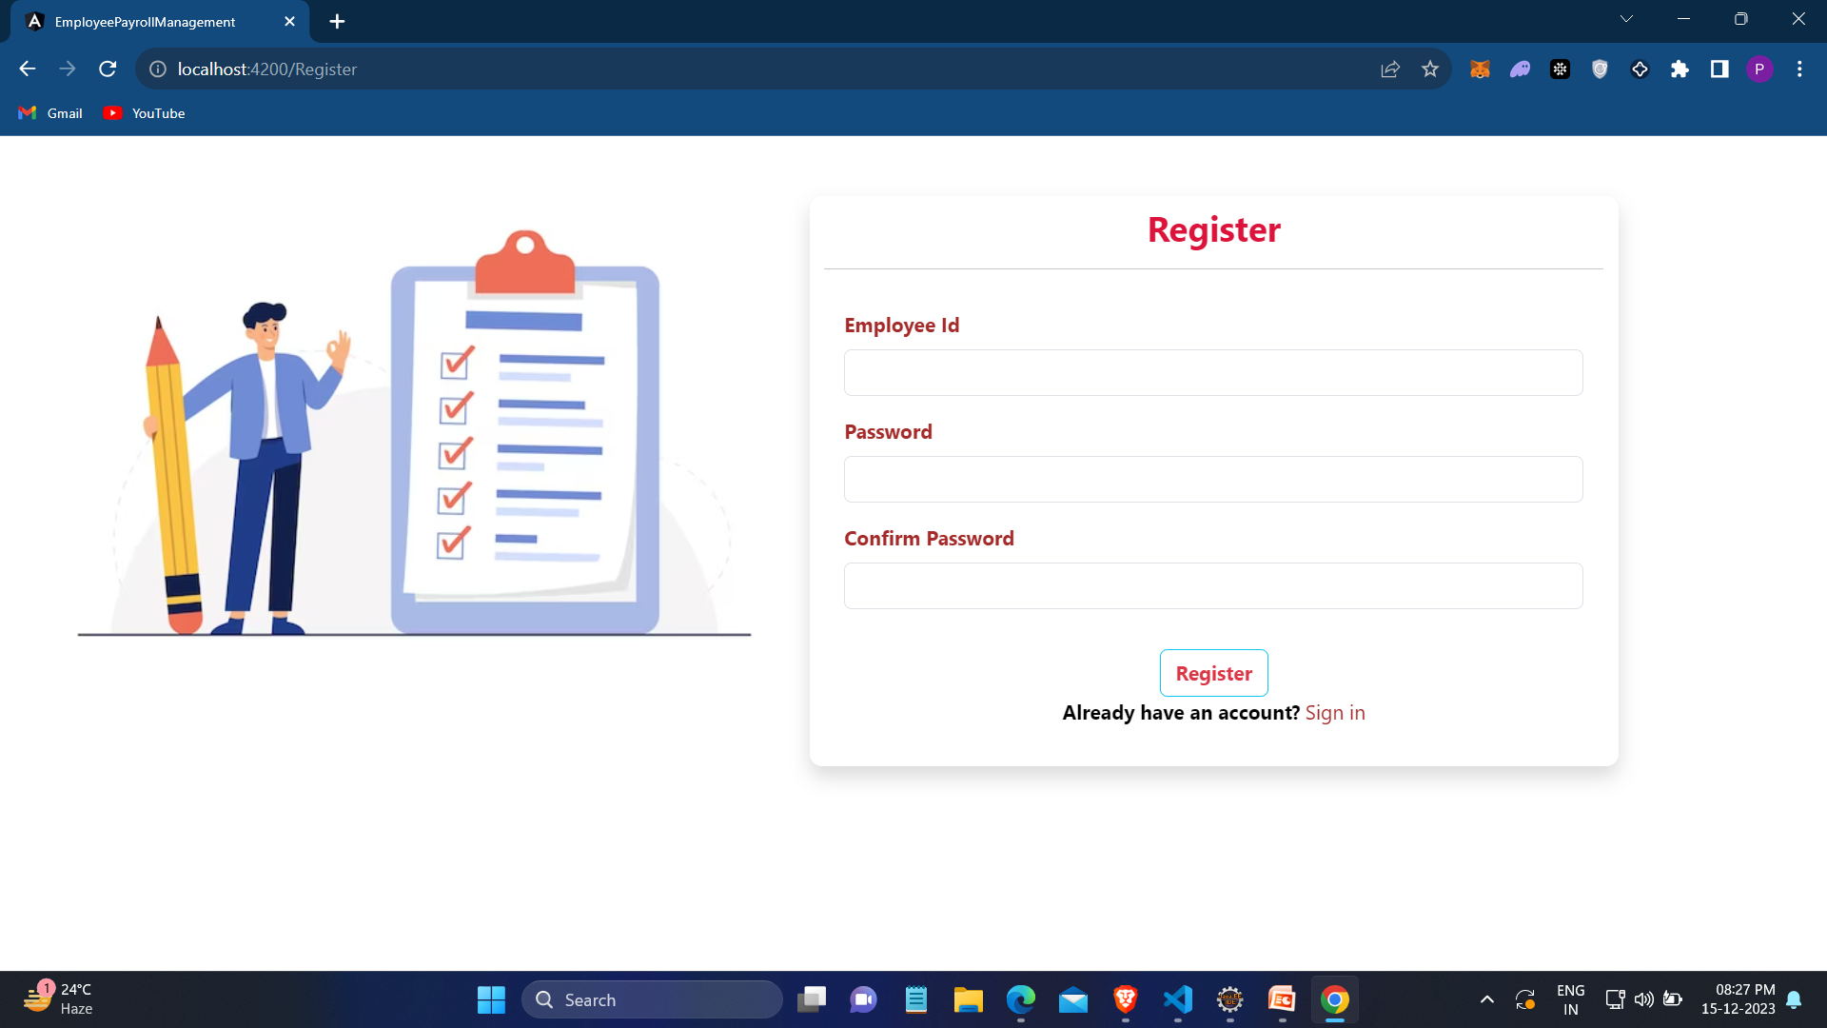
Register Page:

Slide 15
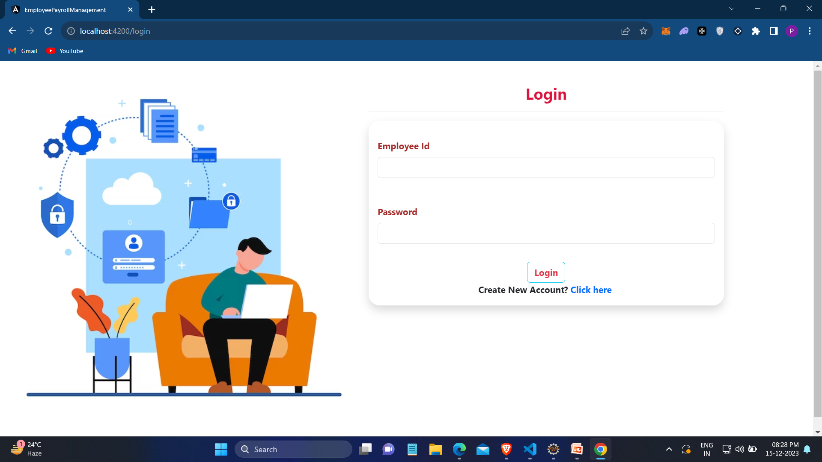
Login Page:

Slide 16
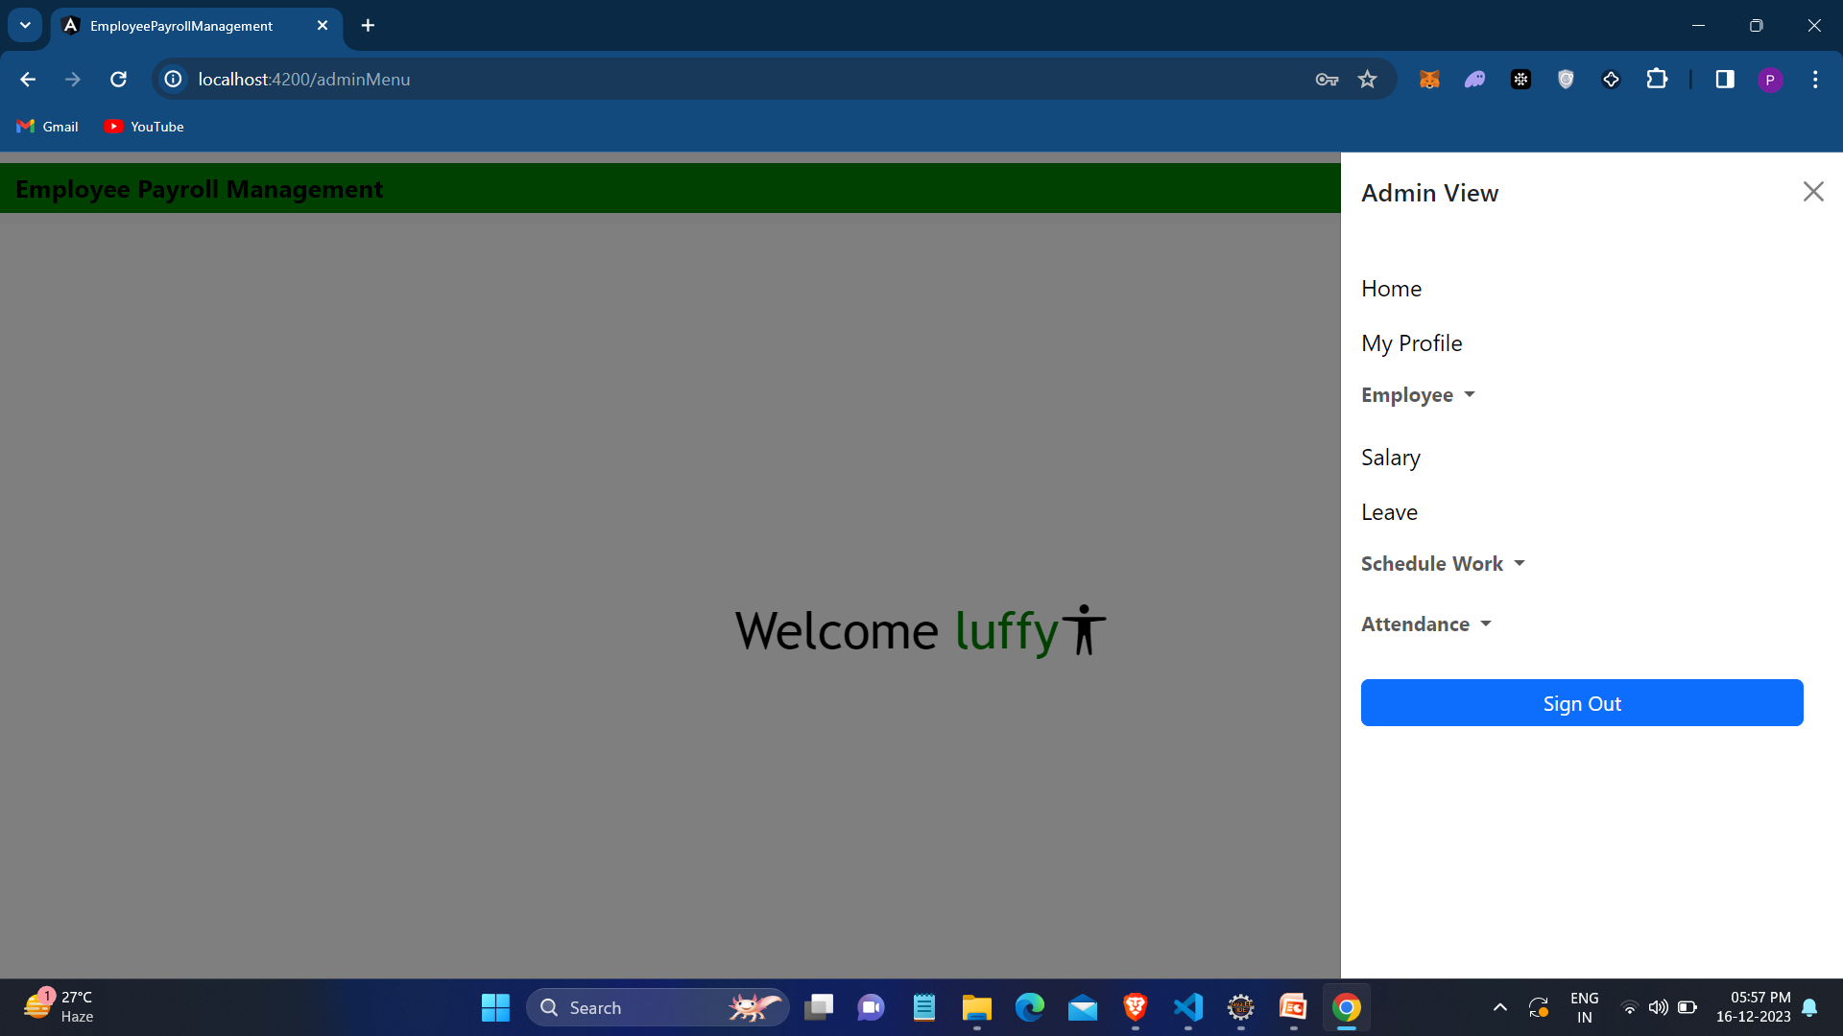
Admin Page:

Slide 17
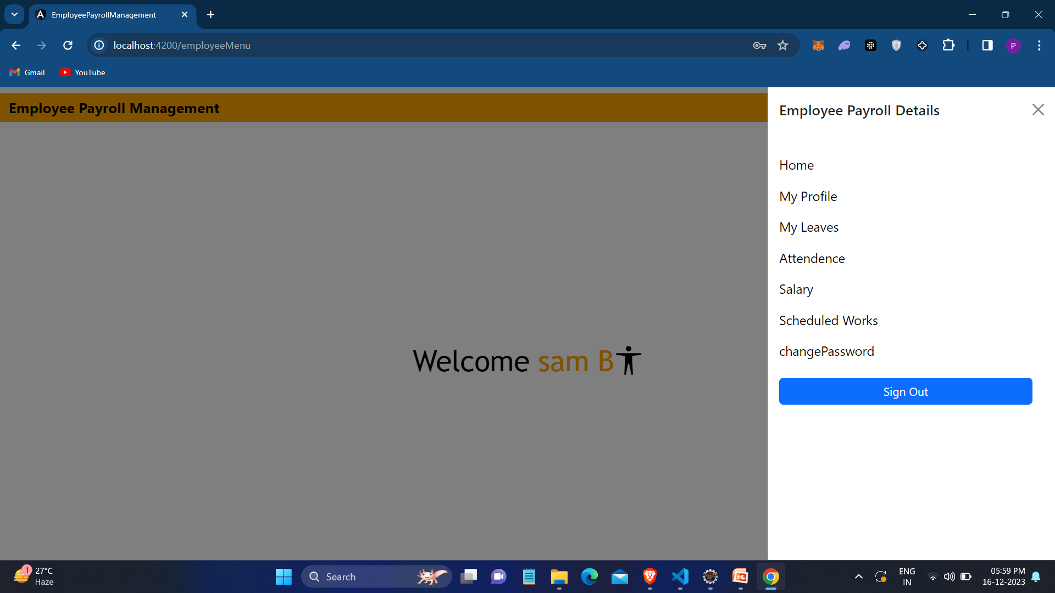
Employee Page:

Slide 18

Update Profile
Update profile :The admin and employee can view and update the profile.

Slide 19
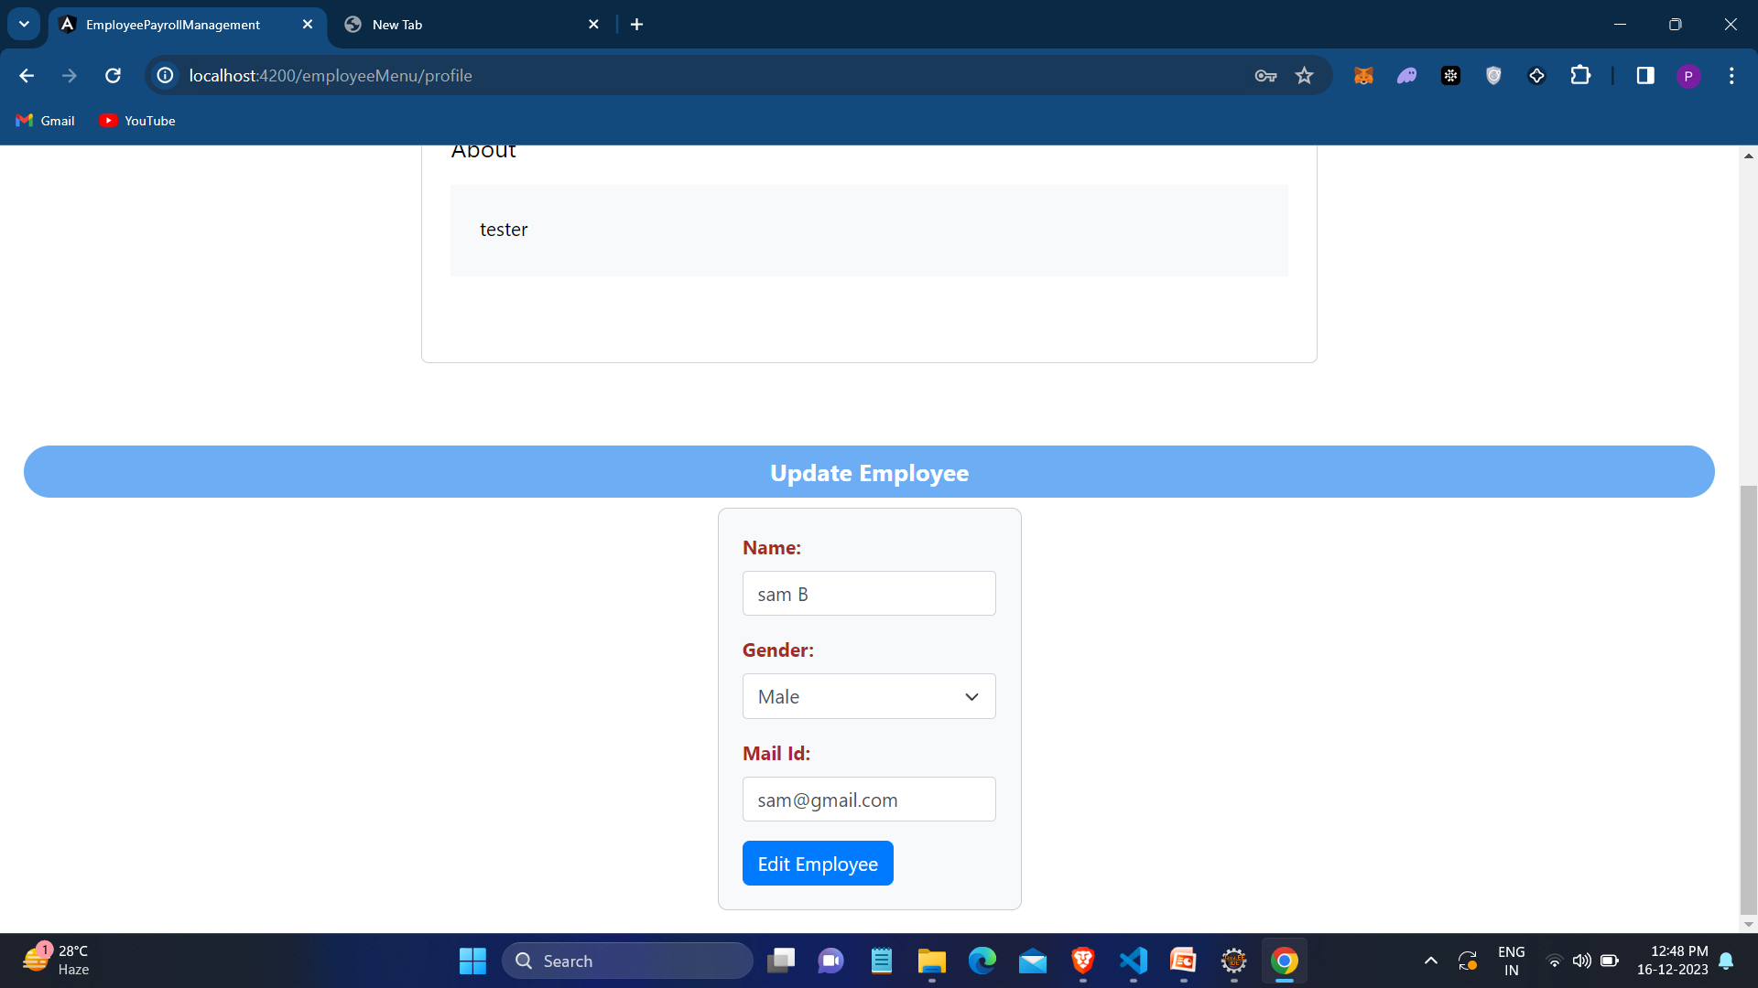
Screenshot of Updating Profile

Slide 20

Adding and Viewing Employees
Add : Growing your team... Onboarding new members is a simple process—just provide the necessary details.
View : You can also view your workforce enhanced organization and efficient management.

Slide 21
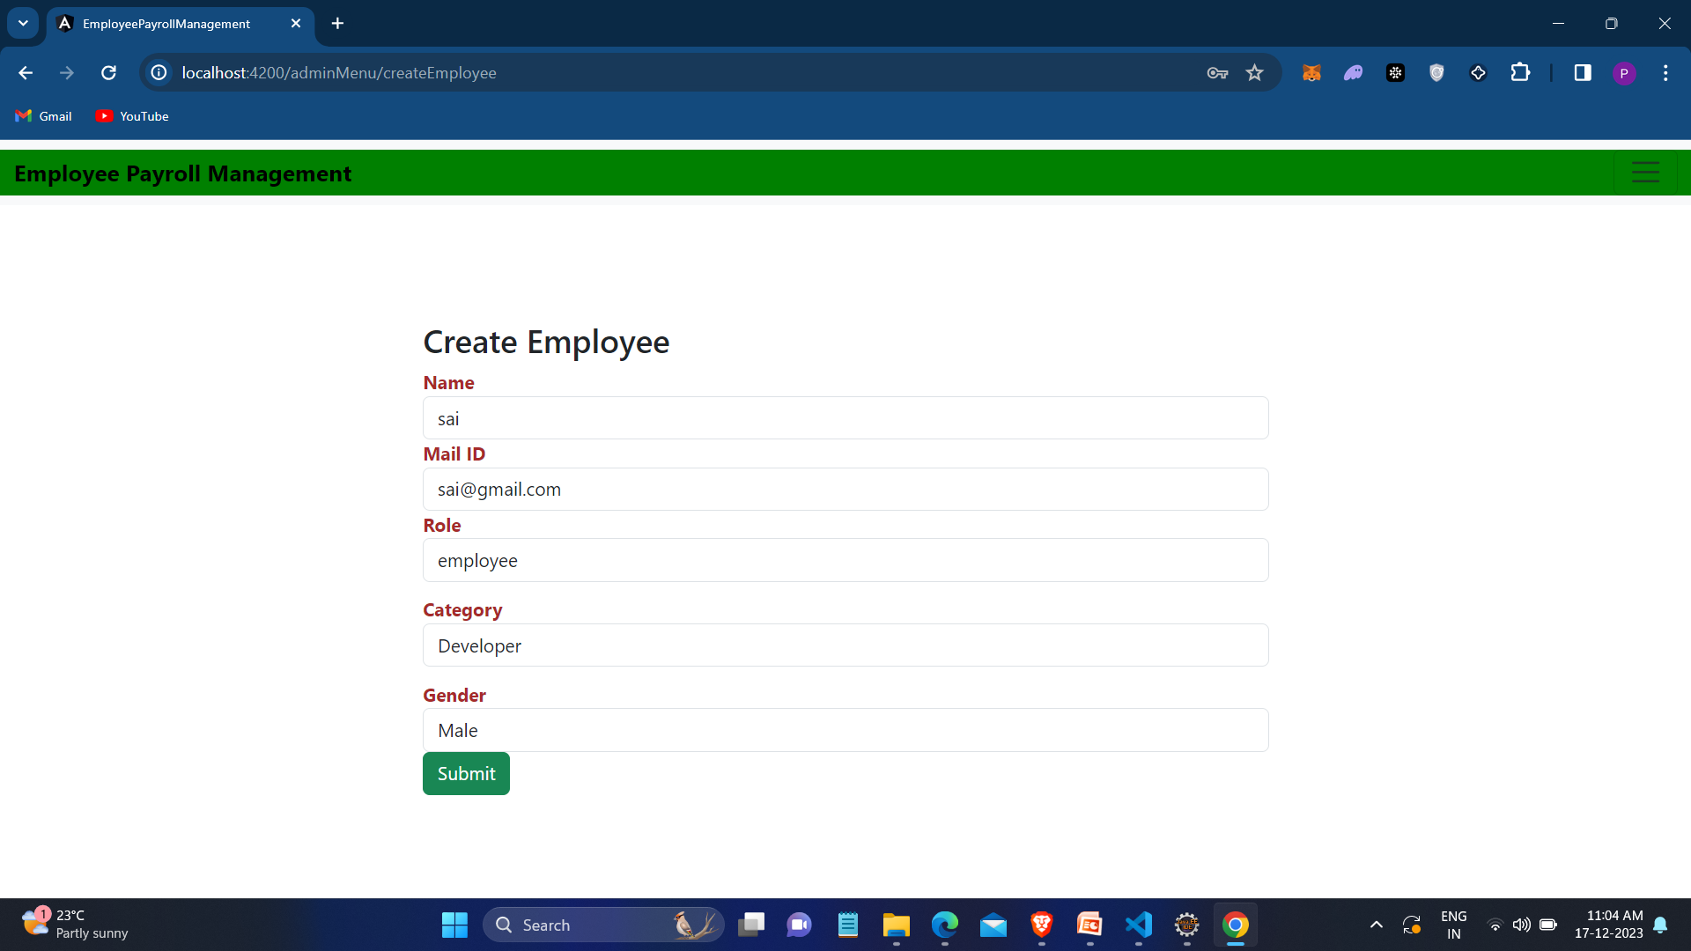
Screenshot for Adding Employees

Slide 22
Editing and Deleting Employees
Edit : You can effortlessly update employee details to align with their current responsibilities.
Delete : eliminating employee records is a hassle-free process, maintaining precision in your records.

Slide 23
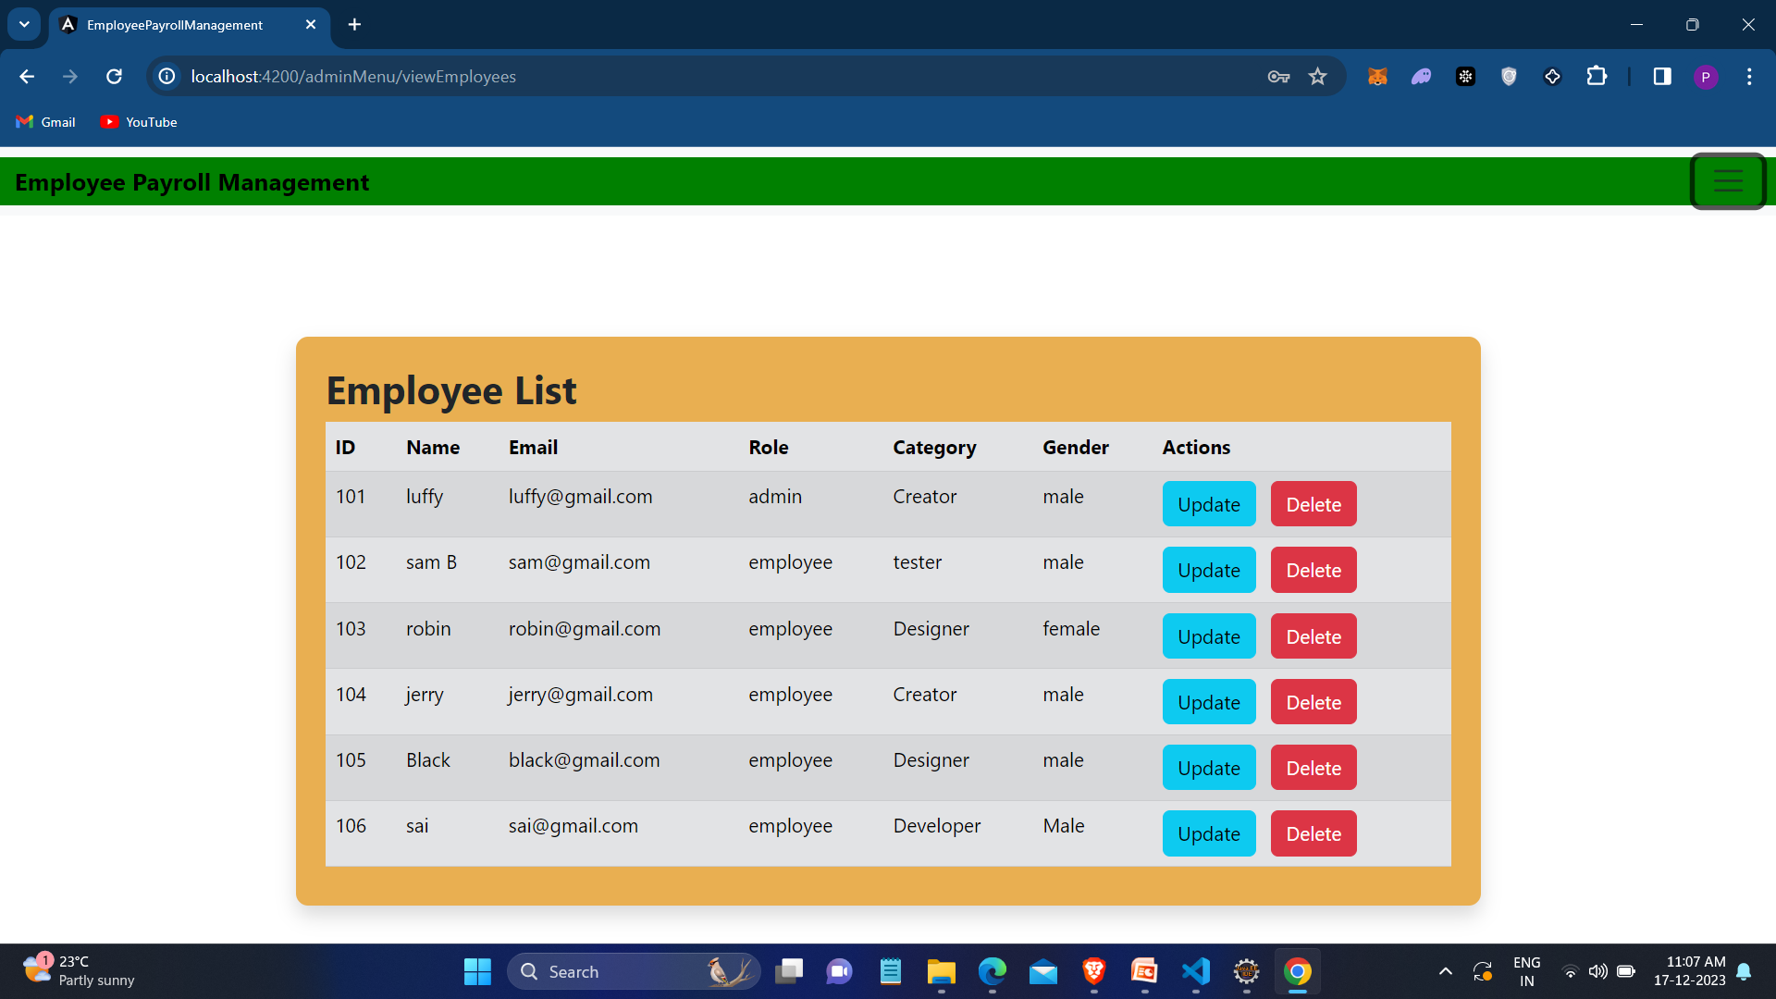
Screenshot for Edit/Delete Employees

Slide 24

Add/Edit/Delete Schedule work of Employees
Effortlessly add, update, or remove schedules as necessary, promoting smooth operations.
Obtain a comprehensive perspective on work schedules, facilitating optimal coordination.

Slide 25
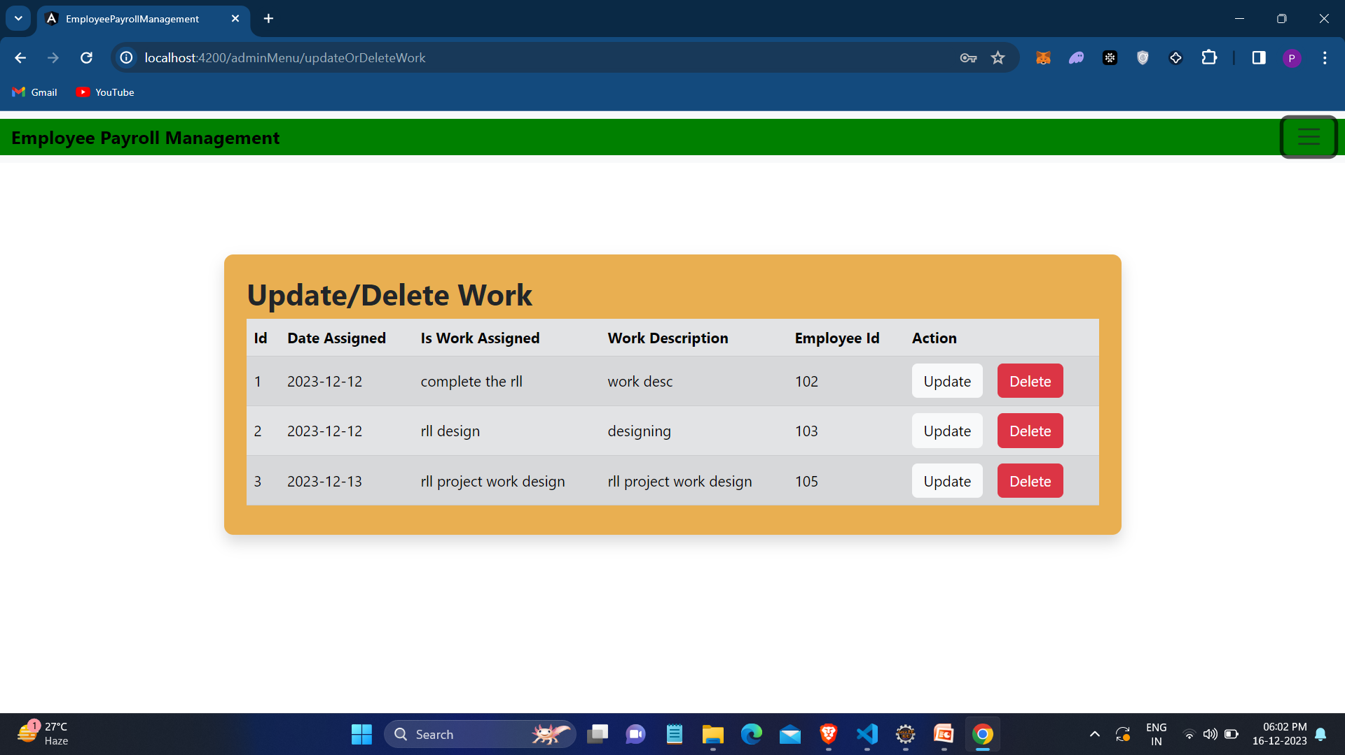
Screenshot for Edit and Deleting Scheduled work

Slide 26
View Schedule work of Employees
Optimize the handling of employee schedules through our user-friendly system.
Simplify workforce management and elevate productivity with ease.

Slide 27
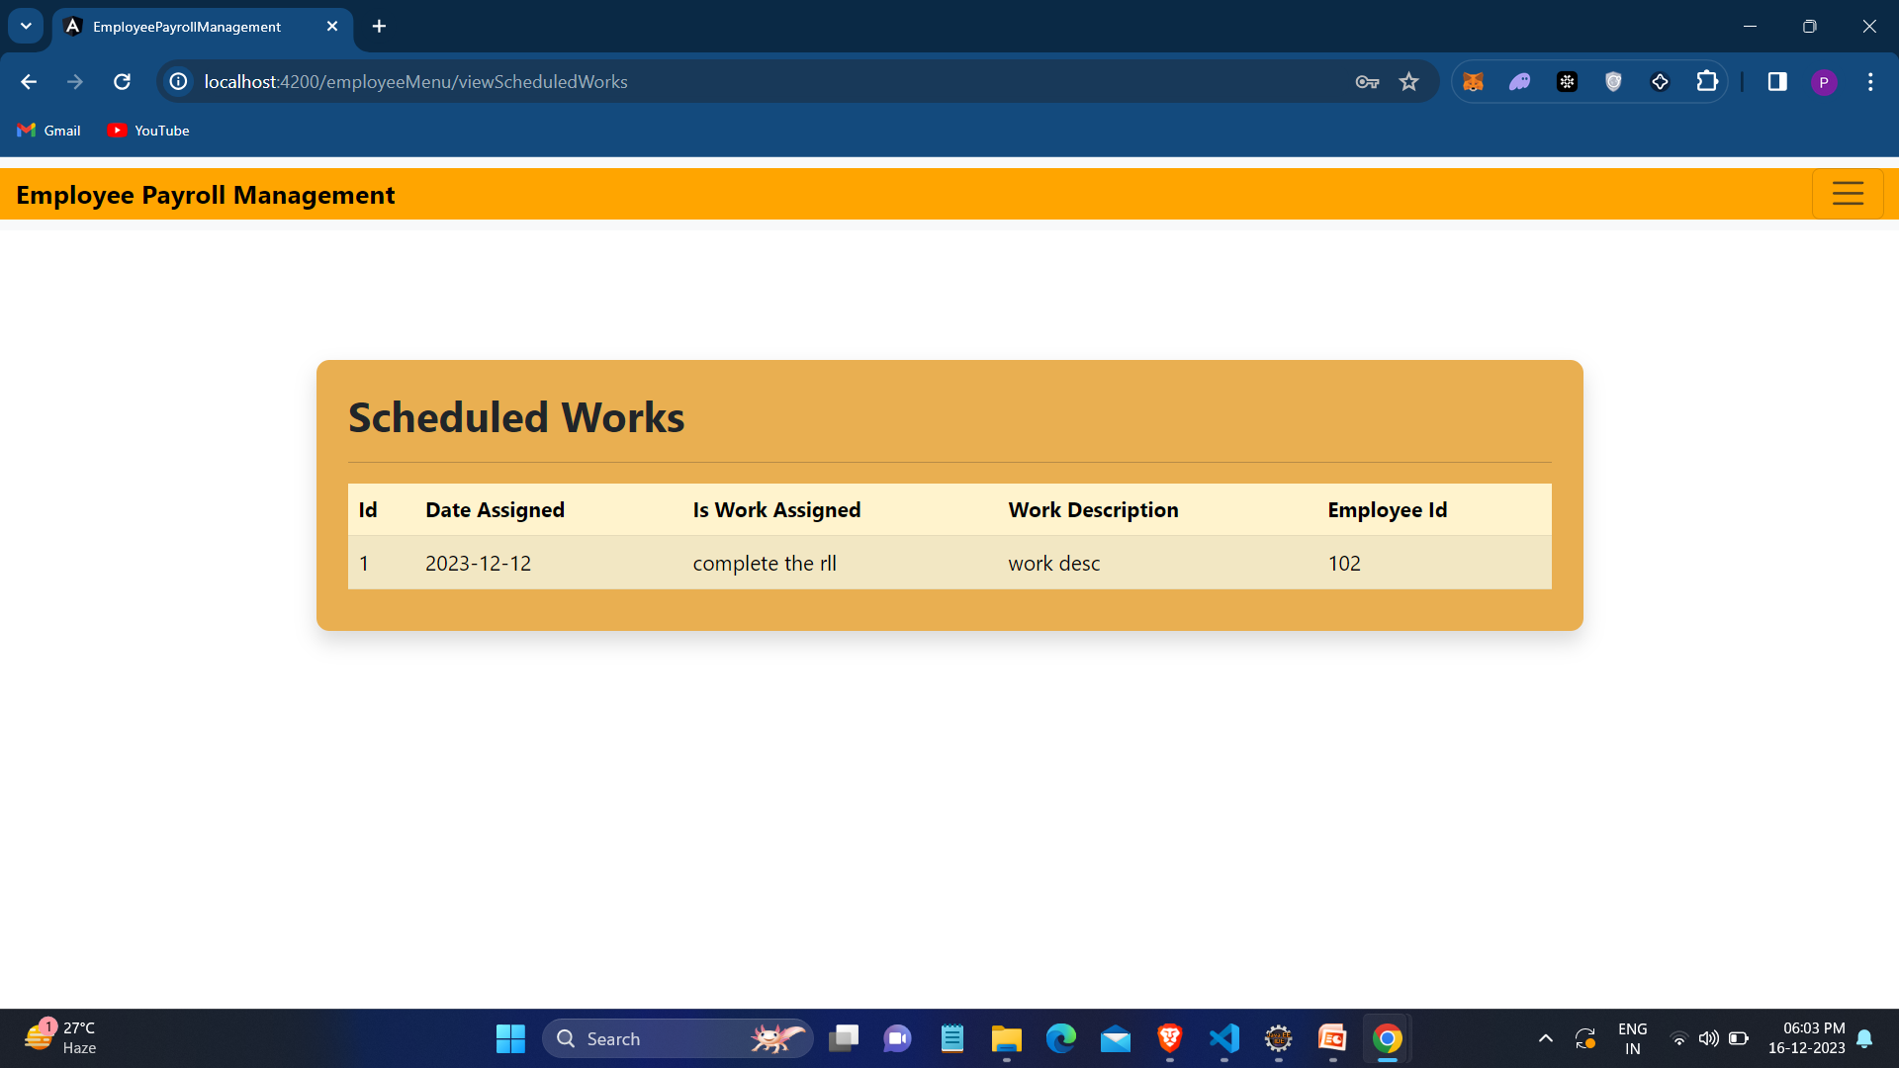
Screenshot for Viewing Scheduled work

Slide 28

Add, Edit and Delete Leaves of Employees
Apply: Recording leave details for employees is simple. Just enter the dates and reasons, and you're good to go!
Edit: Making adjustments to leave dates? No worries! Effortlessly edit leave records to align with new plans.
Delete: Plans shifted? Deleting leave entries is easy, maintaining precise and up-to-date records.

Slide 29
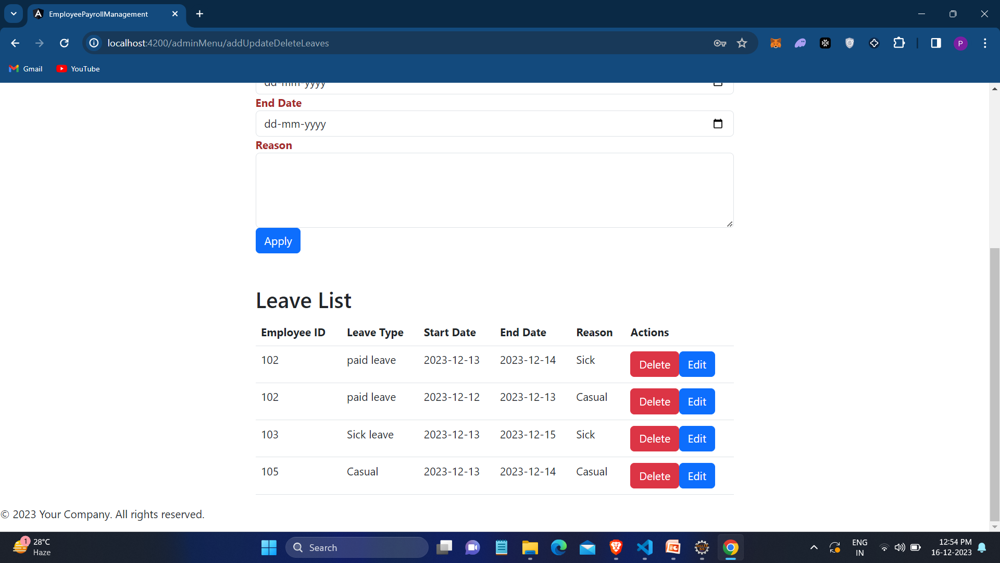
Screenshot for Edit and Delete Leaves

Slide 30
View Leaves of Employees
View: Obtain a swift summary of employees on leave and their schedules. Stay organized and plan effectively for the future.

Slide 31
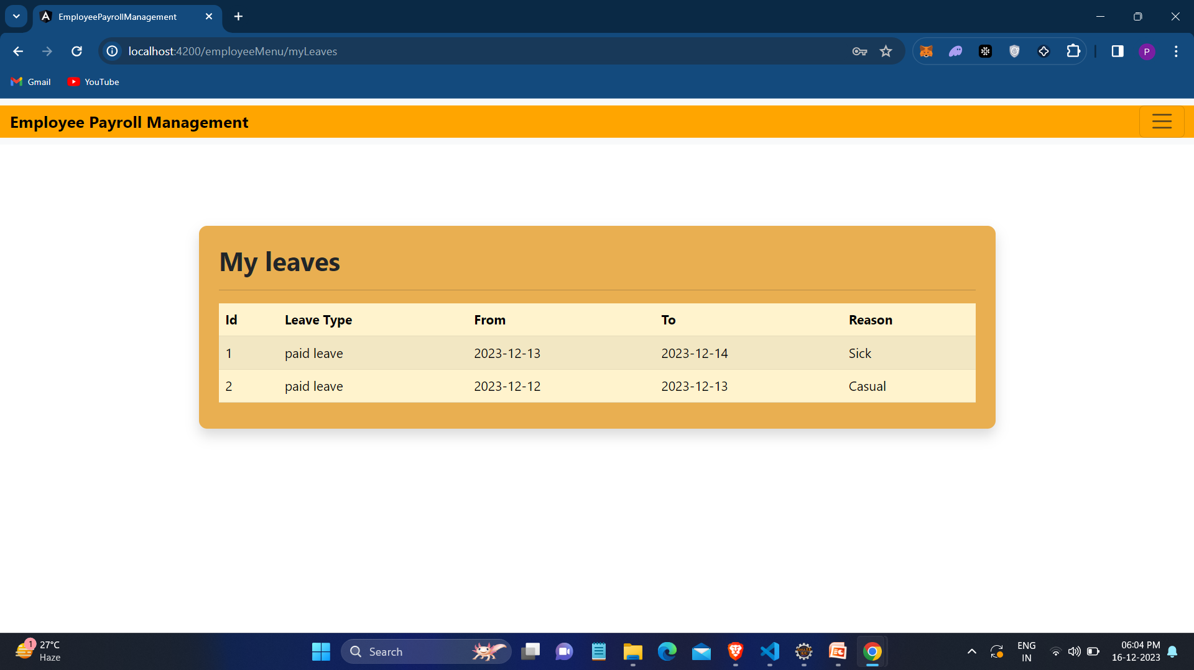
Screenshot for View Leaves

Slide 32

Add/Edit/Delete Attendance of Employees
Add : Capturing employee attendance is effortless. Simply enter the dates they worked, and you're all set!
Edit: Made an error in the attendance log? Not an issue! Easily revise attendance records to reflect the accurate hours.
Delete: Circumstances evolving? You can delete attendance entries without any difficulty, ensuring precise record-keeping.

Slide 33
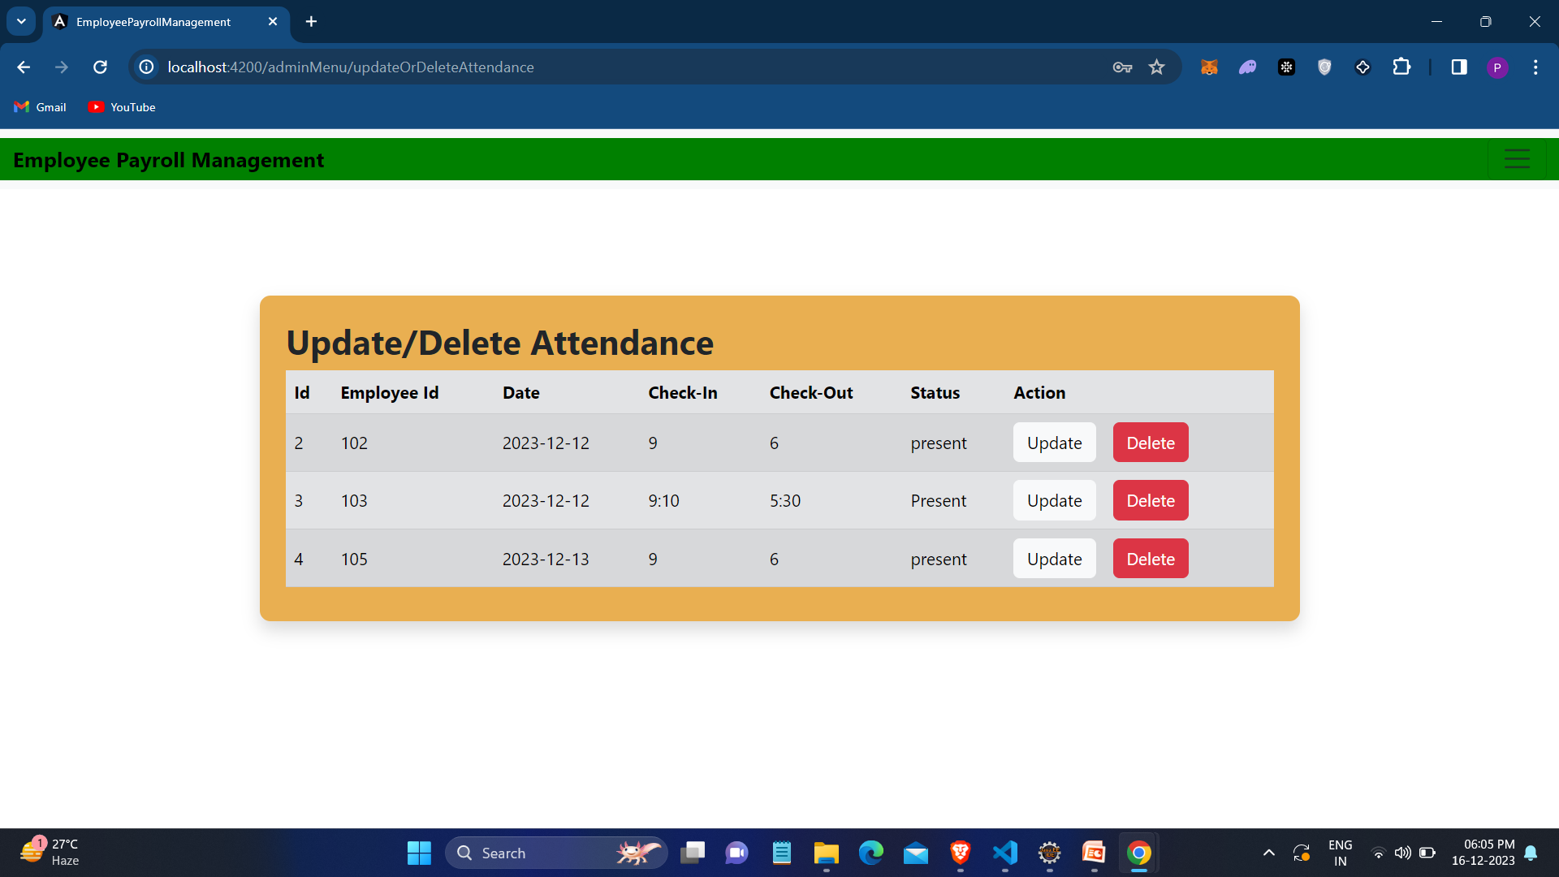
Screenshot for Edit and Delete Attendance

Slide 34

View attendance of Employees
View: Need to know who was present and when? Get a quick snapshot of attendance to stay organized and plan effectively

Slide 35
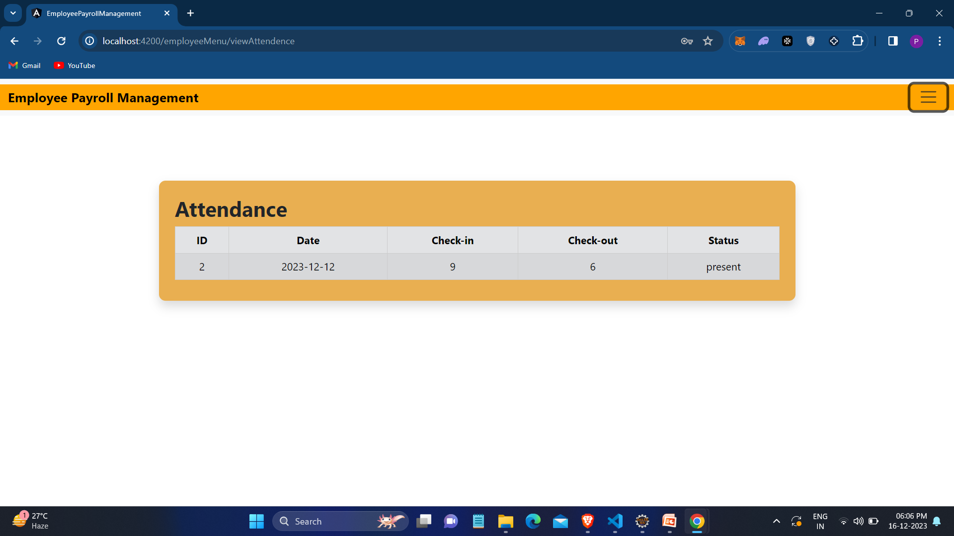
Screenshot for View Attendance

Slide 36

Add/Edit/Delete Salary of Employees
Add: Handling employee salaries is straightforward. Just input the details, and you're ready to go!
Edit: Require adjustments to salary figures? No problem! Easily modify salary records as necessary.
Delete: Circumstances evolving? You can delete salary entries without any hassle, maintaining accurate records.

Slide 37
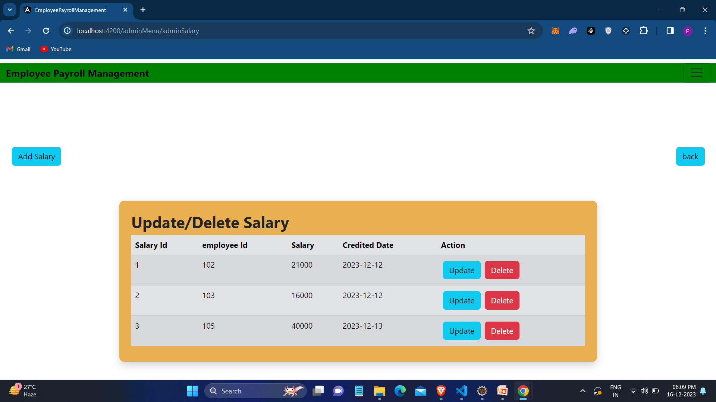
Screenshot for edit and delete Salary

Slide 38

View and Download Salary slips of Employees
View: Reviewing your salary details is trouble-free. With just a click, you can access and see your earnings.
Download: Require a copy? You can download your salary slip whenever needed.

Slide 39
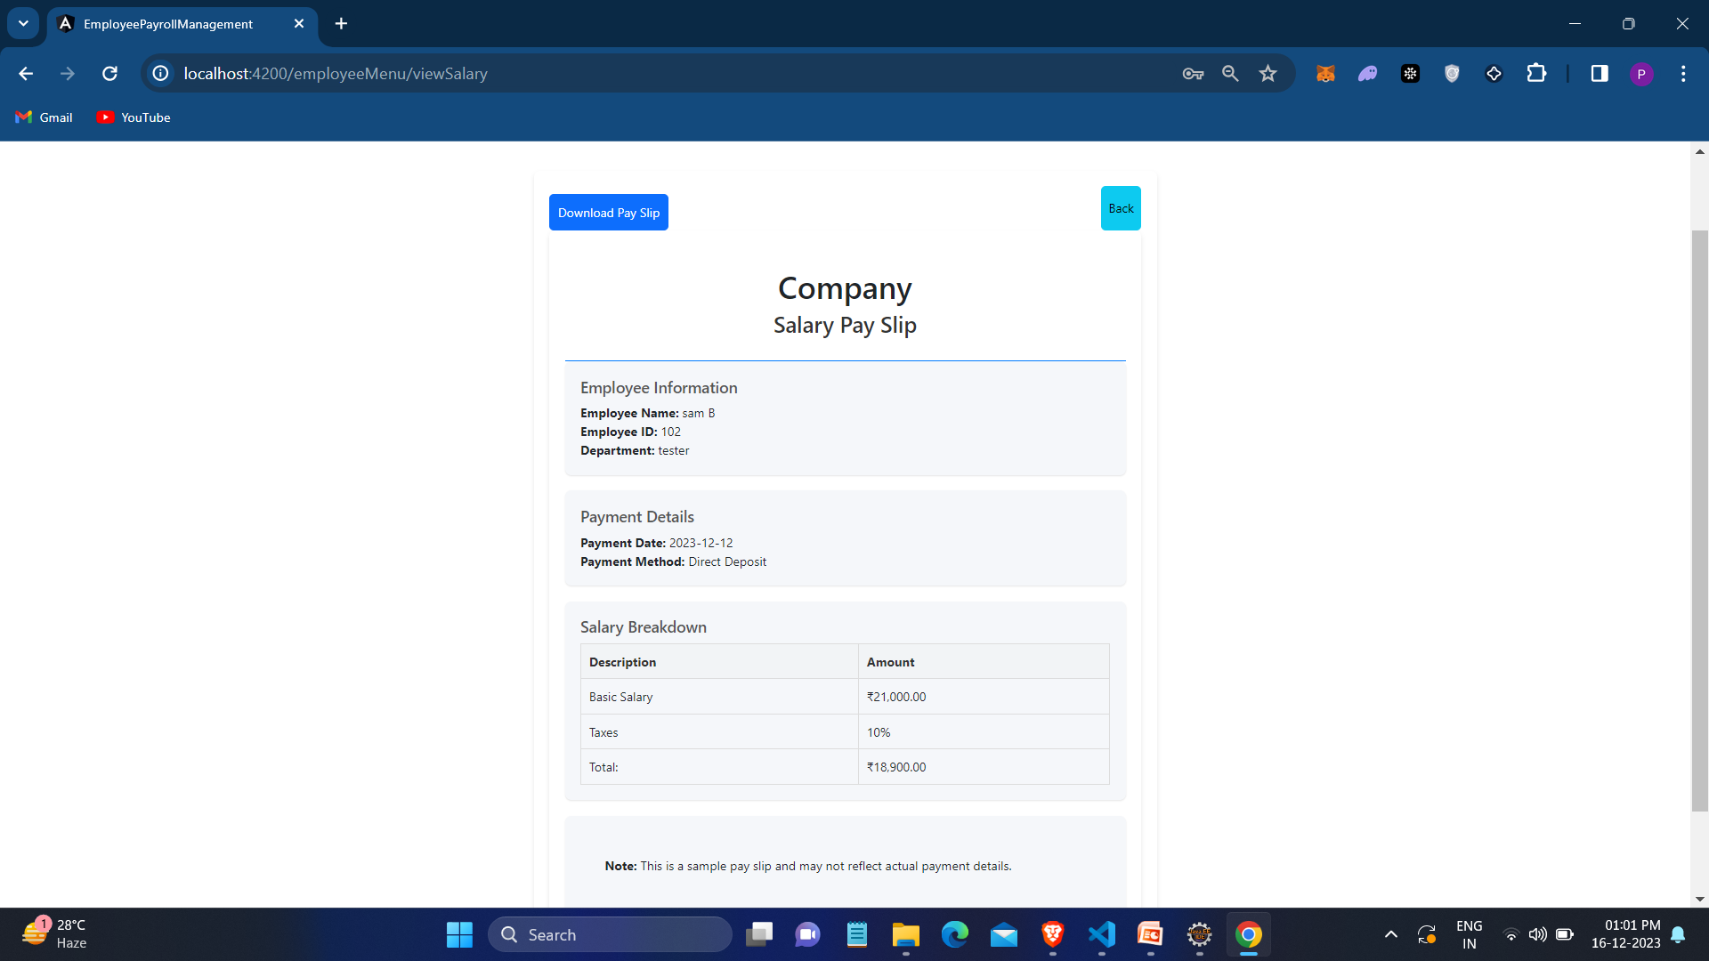
Screenshot for View and Download Salary Slip

Slide 40
Conclusion
Tailored for small organizations, our project caters to both admins and employees, particularly suitable for workplaces with a limited team. Admins wield the authority to add, update, and remove employee information, manage new hires, and set Salaries.
Accessible records and monthly payments contribute to the project's goal of simplifying processes, saving time, cutting costs, and ensuring effective record management for smooth operations.

Slide 41


